Slide 1
Creating an Effective Fundraising Strategy in the Asian Context Strategy Development in KOREA Hyunkyung Jun Manager, Research and Education Team The Beautiful Foundation

Slide 2
IWRM 2014 – Strategy Development in Korea

Slide 3
Korea 2000
The Beautiful Foundation is founded.
We learned fundraising. But…
“What can we do for fundraising
in Korea??”
IWRM 2014 – Strategy Development in Korea

Slide 4
ANALYSIS

Slide 5
Fundraising history
After WWII, there were too much asking for donation on the street.
Government made a law that prohibit fundraising in public. Only government and few special organization could fundraising campaign in public.
There have been national fundraising campaign in every year
IWRM 2014 – Strategy Development in Korea

Slide 6
Korea 2000
Awareness channels of giving(2000)
: Mass media
IWRM 2014 – Strategy Development in Korea

Slide 7
Korea 2000
The month when people give the most amount : December
IWRM 2014 – Strategy Development in Korea

Slide 8
Korea 2000
The main reason for not giving
- Financial status, Mistrust of donation recipient

Slide 9
Identifying fundraising priority
We needed to expand donation market in Korea.
-We needed to improve people’s understanding about donating.
-We needed to change people’s pattern of donation.
IWRM 2014 – Strategy Development in Korea

Slide 10
Setting fundraising objectives
Make people feel free from burden of donation. People have an image about donation. The rich donate big money.
Make giving -Emotional, Human, and Fun.
IWRM 2014 – Strategy Development in Korea

Slide 11
Some Options Generated
1% sharing campaign is
Easy to explain
Match to mass media campaign
Can change the action of many peoples
1% sharing : various items
Donor Designated Fund
Legacy Campaign

Slide 12
Formulate fundraising target
Generate options to pilot

Slide 13
Develop the strategy
Make hundreds of fundraising idea paper.
Try out small pilots.
Scale up the best pilot program.
IWRM 2014 – Strategy Development in Korea

Slide 14
The Beautiful Foundation
1% Sharing Campaign
√ The principal program of the Foundation
√ Aims to popularize regular small-sum donations
√ 1% symbolizes the smallest amount one can share without burden
√ Diverse methods of sharing
- Salary, revenue, budget, allowance, pension…
- Talent, skills, expertise, services
IWRM 2014 – Strategy Development in Korea

Slide 15
1% Sharing Campaign
IWRM 2014 – Strategy Development in Korea

Slide 16
1% Sharing Campaign Implementation Details

Slide 17
Various 1%
Pocket money 1%
Shopping 1%
Theater 1%
State pension 1%
Bequest 1%
Birthday gift 1%
IWRM 2014 – Strategy Development in Korea

Slide 18
Seasonal
Worldcup 1%
Valentine day 1%
IWRM 2014 – Strategy Development in Korea

Slide 19
Mass media
Work with every national daily papers
Make contents for newspaper
- people focus : stories of donors
- Research & Review : Giving Culture in Korea and other countries
- Seasonal contents : Vacation giving, Monthly Campaign
Focus on Donor not Recipient
IWRM 2014 – Strategy Development in Korea

Slide 20
Transparence & Accountability
Allow donors to see monthly account file
Report every staff’s salary structure and amount
New Reporting Form : not only total or financial account, but every grant making and story of recipients
Accounting audit
IWRM 2014 – Strategy Development in Korea

Slide 21
Annual report
IWRM 2014 – Strategy Development in Korea

Slide 22
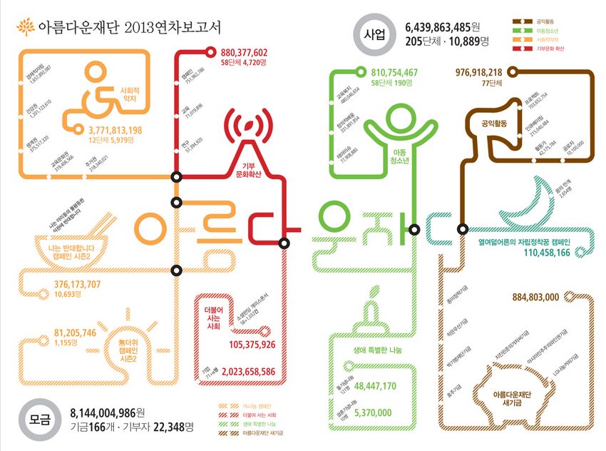
Annual Report
IWRM 2014 – Strategy Development in Korea

Slide 23
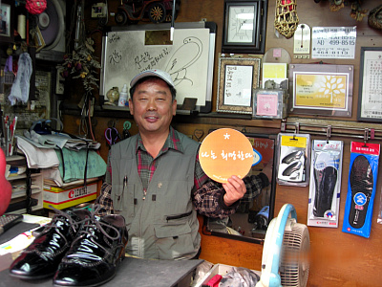
Human Oriented-Donor story
Lee Chang-sik(Shoe repairman)
Granma Kim Kun-ja
IWRM 2014 – Strategy Development in Korea

Slide 24
Human Oriented – Personal Brand
IWRM 2014 – Strategy Development in Korea

Slide 25
Design Strategy
IWRM 2014 – Strategy Development in Korea

Slide 26
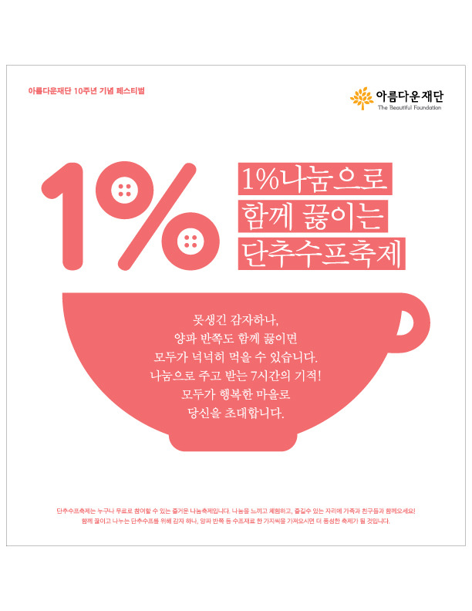
Design Strategy
IWRM 2014 – Strategy Development in Korea

Slide 27
What is the competitor of donation?
The average of annual donation amount
219USD
The average of annual mutual giving
755USD
We need to think about the mutual giving
IWRM 2014 – Strategy Development in Korea

Slide 28
What is the mutual giving in Korea?
We call it “경조사비”(kyungjosa-bi)
Many people feel burden but inevitable
That is not only money but also evidence of relationship
Wedding, 1^{st / 60th /} 70th birthday party, Funeral
There are money delivery service for people in busy
IWRM 2014 – Strategy Development in Korea

Slide 29
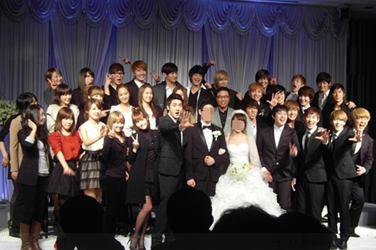
Opportunity
Spoiled Ceremony
Enter the ceremony place
-> give money to the desk
(write the name, average is 30,000-50,000won)
-> see the wedding ceremony(15-20min.)
-> have meal(buffe, the value is 40,000-50,000won. Sometimes host give a meal voucher or money to the guest)
IWRM 2014 – Strategy Development in Korea

Slide 30
Suggest Alternatives
Add meaningful donation
Donate all the money
Don’t serve meal or ceremony itself
IWRM 2014 – Strategy Development in Korea

Slide 31
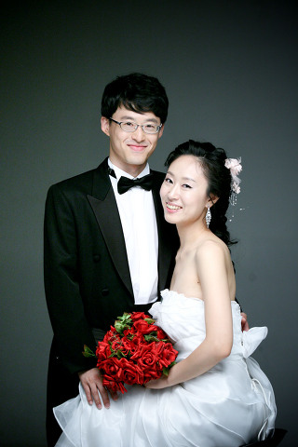
Wedding donation
IWRM 2014 – Strategy Development in Korea

Slide 32
The First birthday Donation
IWRM 2014 – Strategy Development in Korea

Slide 33
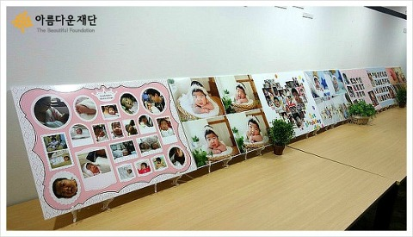
The First Birthday Donation
IWRM 2014 – Strategy Development in Korea

Slide 34
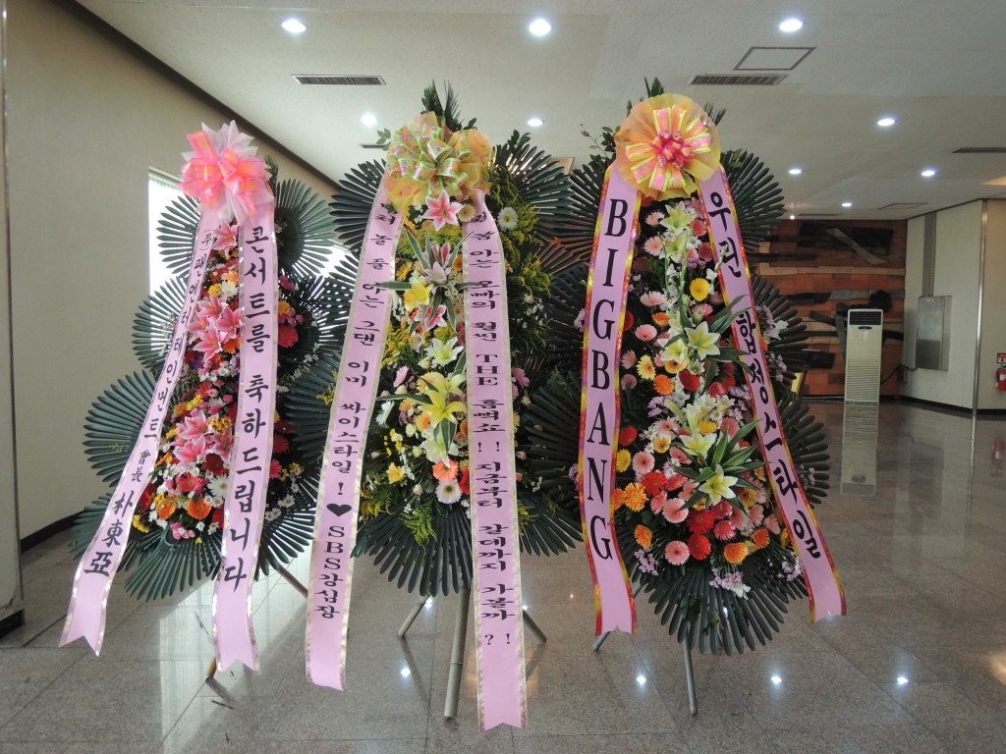
Other Ceremony
Flower Wreath Problem
IWRM 2014 – Strategy Development in Korea

Slide 35
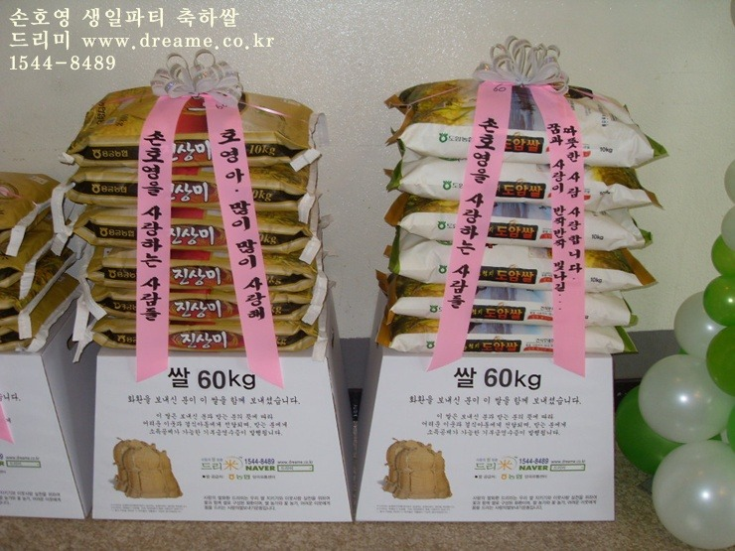
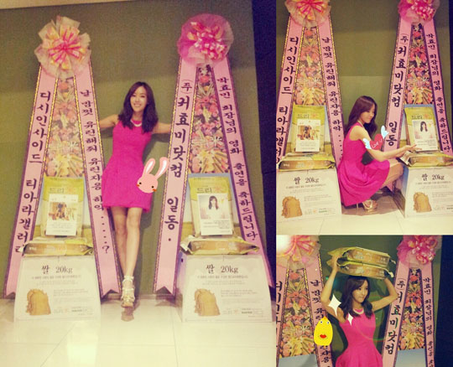
Other Ceremony
Rice Donation Wreath
IWRM 2014 – Strategy Development in Korea

Slide 36
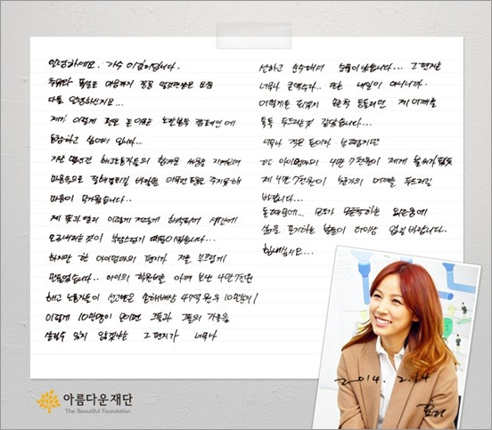
Fandom Donation
Star leading case
IWRM 2014 – Strategy Development in Korea

Slide 37
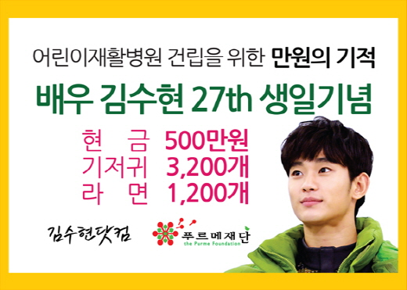
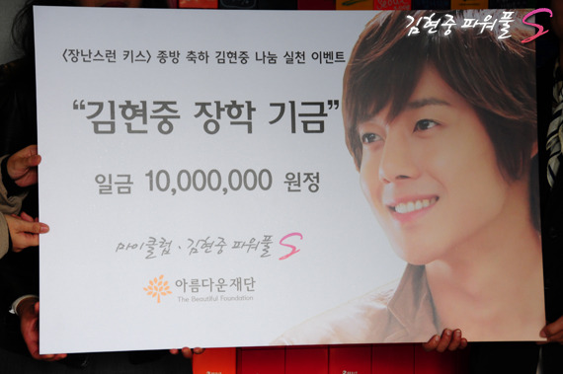
Fandom Donation
Fan club leading case
IWRM 2014 – Strategy Development in Korea

Slide 38
EVALUATION
2000 TO 2009

Slide 39
Big Success Experience
Donor : 4 -> 103,000
Donation : 10 billion won per year
‘1% sharing’ became general brand in korea
Benchmarked by other NPO
IWRM 2014 – Strategy Development in Korea

Slide 40
People is changing
IWRM 2014 – Strategy Development in Korea

Slide 41
Korea 2000
The main reason for not giving
- Financial status, Mistrust of donation recipient

Slide 42
People is changing
Regularity of Donation
IWRM 2014 – Strategy Development in Korea

Slide 43
The Beautiful Foundation
IWRM 2014 – Strategy Development in Korea

Slide 44
The Beautiful Foundation
IWRM 2014 – Strategy Development in Korea

Slide 45
Giving culture in Korea
IWRM 2014 – Strategy Development in Korea

